Slide 1
Java Persistence Query Language [JPQL ]

Slide 2
JPQL
Object Oriented Version of SQL
Java Persistence Query Language (JPQL) is an object model focused query language similar in nature to SQL.
JPQL understands notions like inheritance, polymorphism and association.
JPQL is a heavily-inspired-by a subset of HQL. A JPQL query is always a valid HQL query, the reverse is not true however.
Notes:
Hibernate uses a powerful query language (HQL) that is similar in appearance to SQL. Compared with SQL, however, HQL is fully object-oriented and understands notions like inheritance, polymorphism and association.
JPQL can retrieve information or data using SELECT clause, can do bulk updates using UPDATE clause and DELETE clause.
INDIVIDUAL FIELDS
SELECT i.firstProperty, i.secondProperty FROM ObjectName i WHERE i.id=10Executing this query will return a list of Object[], where each array contains the selected properties of one object.

Slide 3
Anatomy of a Query
THIS is Effectively what member.findAll() does:
Query query = entityManager.createQuery(select m from Member”);
List<Member> members = (List<Member>) query.getResultList();
Query query = entityManager.createQuery("select m from Member m
where m.memberNumber = :number");
Member member=
(Member) query.setParameter("number", number).getSingleResult();
Entity references are Case Sensitive
Parameterized Query
Notes:
[ NO Insert ]
JPQL UPDATE queries provide an alternative way for updating entity objects. Unlike SELECTqueries, which are used to retrieve data from the database, UPDATE queries do not retrieve data from the database, but when executed, update the content of specified entity objects in the database.
Updating entity objects in the database using an UPDATE query may be slightly more efficient than retrieving entity objects and then updating them, but it should be used cautiously because bypassing the EntityManager may break its synchronization with the database. For example, the EntityManager may not be aware that a cached entity object in its persistence context has been modified by an UPDATE query. Therefore, it is a good practice to use a separate EntityManagerfor UPDATE queries.
Deletes [ & Updates] [batch] are also possible
int count = entityManager.createQuery(“delete from Member").executeUpdate();
NOTE: executeUpdate() can be used in a bulk process as it is faster due to bypassing the persistent context

Slide 4
Named & Ordinal Parameters
Alternative to named parameters [:name]
Query query = entityManager.createQuery("select m from Member m
where m.memberNumber = ?1");
Member member=
(Member) query.setParameter(1,number).getSingleResult();
The form of ordinal parameters is a question mark (?) followed by a positive int number.
Aside from syntax - named parameters and ordinal parameters are identical.
Named parameters provide added clarity - preferred over ordinal parameters.
They BOTH prevent SQL injection
dangerous characters are automatically escaped by the JDBC driver
Notes:
Using parameters - any dangerous characters should be automatically escaped by the JDBC driver.

Slide 5
JPQL Syntax
CLAUSES:
SELECT, FROM, WHERE, GROUP BY, HAVING and ORDER BY
OPERATORS
Navigation operator (.)
Arithmetic operators:
* (multiplication), / (division), + (addition) and - (subtraction).
Comparison operators:
=, <>, <, <=,>, >=, IS [NOT] NULL, [NOT] BETWEEN,
Logical operators: AND, OR, NOT. Hibernate JPQL
Oracle JPQL
OpenJPA JPQL
ObjectDB JPQL
Notes:
TREAT; SIZE; MEMBER OF;

Slide 6
JPA Named Query
Declaration:
@Entity
@NamedQuery(name = “Member.findByNumber", query = "select m from Member m where m.memberNumber = :number")
public class Member{
Usage [in MemberDaoImpl]:
Query query = entityManager.createNamedQuery(“Member.findByNumber”);
Member member=
(Member) query.setParameter("number", number).getSingleResult();
Multiple Declarations:
@NamedQueries(value = {@NamedQuery(... ) , @NamedQuery(…) } )
VALUE: Static, Precompiled
Notes:
@NamedQuery
static precompiled….

Slide 7
Native Query
JPA supports native SQL. You can create these queries in a very similar way as JPQL queries and they can return managed entities
VALUE:
Takes advantage of database vendors specific features…
Handles very complex and DB-optimized SQL query
In JPQL
It is very difficult to achieve the performance of a
DBA-optimized Query
Notes:
No cache; no JPA optimization.. lose the portability from DB – DB specific
ORM does not parse the SQL statement, so you can use any SQL statement that is supported by your database.

Slide 8

Get an Individual class Object
The simplest way to map the result of a native query into a managed entity is to select all properties of the entity and provide its as a parameter to the createNativeQuery method.
Query query = entityManager.createNativeQuery("SELECT m.* FROM
Member m where m.memberNumber = ?", Member.class);
Member member = (Member) query.setParameter(1,number).getSingleResult();

Slide 9
Native Query Select List
Query query = entityManager.createNativeQuery("SELECT m.member_id, m.age, m.title ,m.firstname, m.lastname, m.memberNumber FROM Member m",Member.class);
List<Object> memberList = (List<Object>) query.getResultList();
Member member = (Member)memberList.get(0);

Slide 10
Stored Procedure
DECLARE:
@NamedStoredProcedureQuery( name = "calculate", procedureName = "calculate",
parameters = {
@StoredProcedureParameter(mode=ParameterMode.IN,type=Double.class, name= "x"),
@StoredProcedureParameter(mode = ParameterMode.IN, type = Double.class, name = "y"),
@StoredProcedureParameter(mode = ParameterMode.OUT, type = Double.class, name = "sum")
}
INVOKE:
StoredProcedureQuery query =
this.entityManager.createNamedStoredProcedureQuery("calculate");
query.setParameter("x", 1.23d);
query.setParameter("y", 4.56d);
query.execute();
Double sum = (Double) query.getOutputParameterValue("sum");

Slide 11
Criteria Query
Criteria API is a programmatic approach to query instead of string based approach as in JPQL.
JPQL:
Query query = entityManager.createQuery("select m from Member m
where m.memberNumber =:number");
Criteria API Version:
CriteriaBuilder criteriaBuilder = entityManager.getCriteriaBuilder();
CriteriaQuery<Member> query= criteriaBuilder.createQuery(Member.class);
Root<Member> memberRoot = query.from(Member.class);
query.select(memberRoot);
query.where(criteriaBuilder.equal(memberRoot.get("memberNumber"), number) );
Member member=
(Member) entityManager.createQuery(query).getSingleResult();
Good for Dynamic queries..See CriteriaApi demo
Pretty verbose and complex for simple queries
Notes:
OneToOneUni
Both HQL and JPQL are non-type-safe ways to perform query operations. Criteria queries offer a type-safe approach to querying.

Slide 12
Named Entity Graph
RAISON D’ETRE:
FetchType.LAZY - is the recommendation for performance & scaling
Hydrating the graph becomes an issue
Manually “walking” the graph is complex & “tedious” –requires:
Maintaining custom queries for variations of the graph
OR
Iteratively query parts of graph as needed
Entity Graph Alternative
Declaratively Identify attributes to fetch from the database.
Independent of specific query
Can be used either as a Fetch or a Load Graph.
Fetch graph - only the attributes specified by the entity graph will fetched
Load graph - attributes not specified keep their default fetch type
i.e., EAGER will occur
Notes:
For use on findall, etc…
http://www.radcortez.com/jpa-entity-graphs/
EXAMPLES:
EntityGraph<Movie> fetchAll = entityManager.createEntityGraph(Movie.class); // create a “dynamic”
public List<Movie> listMovies(String hint, String graphName) { // use with resultset
return entityManager.createNamedQuery("Movie.findAll")
.setHint(hint, entityManager.getEntityGraph(graphName))
.getResultList();

Slide 13
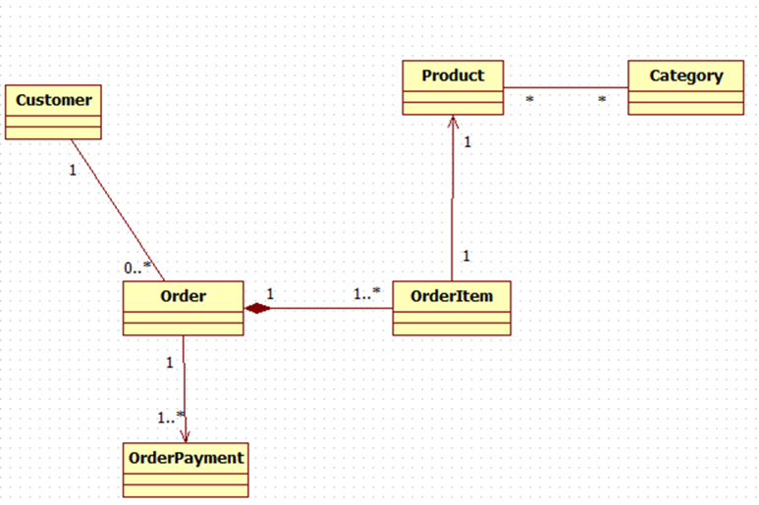
Example
@NamedEntityGraph(name = "graph.Order.items",
attributeNodes= { @NamedAttributeNode(value = "items", subgraph= "items"),
@NamedAttributeNode(value = "payments")} ,
subgraphs = @NamedSubgraph(name = "items",
attributeNodes = @NamedAttributeNode("product")))
This Graph will “hydrate” the OrderPayments, as well as the OrderItems AND the Product on each OrderItem
See NamedEntityGraph Demo
private Set<OrderItem> items = new HashSet<OrderItem>();
private Set<OrderPayment> payments = new HashSet<OrderPayment>();

Slide 14
Query Hints
JPA and Hibernate support a set of hints to provide additional information to the ORM to influence the execution of a query.
Uses:
Set a timeout for query
Use an entity graph
Define the caching of a query result.

Slide 15
Access NamedEntityGraph
OrderDaoImpl.java
EntityGraph graph = entityManager.getEntityGraph("graph.Order.items");
Map hints = new HashMap();
hints.put("javax.persistence.fetchgraph", graph);
Order order = this.findOne(id, hints);
GenericDaoImpl.java
public T findOne( Long id, Map<String,Object> hints ){
return (T) entityManager.find( daoType, id, hints );
}
NOTE: See NamedEntityGraphCartesian for query.setHint() example
A Hint is
Vendor specific Query Property
We SET it:
on a query via setHint method
In the find() and refresh() – by passing in a Map
Query version
query.setHint(("javax.persistence.fetchgraph", graph) .getResultList();
We are telling the find() to use the graph…
Notes:
The Query interface provides the setHint(String name, Object value) method which you have to call for each hint you want to provide.
SEE comments for API version in DEMO
https://blog.jooq.org/2016/06/28/turn-around-dont-use-jpas-loadgraph-and-fetchgraph-hints-use-sql-instead/

Slide 16
JPA Query - Joins
Join combines data from multiple tables as follows:
Construct product of 2 tables
Filter the rows using join condition
WHERE
join condition[boolean] determines if row
is in result set
JPA supports:
Inner Join
Left Outer Join
Notes:
A right outer join retrieves all member and null if a member has no item—not a sensible query in this situation. Right outer joins are rarely used; developers always think from left to right and put the driving table first.

Slide 17
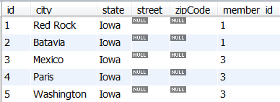

Join Examples
Inner Join
Use: JOIN FETCH
Left Outer Join
Use: LEFT JOIN FETCH
See JPQLJoinTypes Demo
Sean Red Rock
Batavia
Bill Mexico
Paris
Washington
Only where there are matches between the 2 tables
Sean Red Rock
Batavia
Peat
Bill Mexico
Paris
Washington
All rows from “Left Side”
Notes:
Inner join -- combine the columns of 2 tables to a set which you can use within the same query. You can define a join condition that specifies which rows of each table shall be joined with each other. All rows which don’t fulfill the condition are not part of the set.
Left outer Join – Includes All rows on left side[Member] of statement SELECT DISTINCT m FROM Member
Right outer Join – Includes All rows on right side[addresses] of statement SELECT DISTINCT m FROM Member

Slide 18
JPA Right Outer Join
NOT Supported
Right outer joins are rarely used; developers always think from left to right and put the driving table first.
Hibernate specific Version
Query query = session.createQuery("from Member m right outer join m.address a ");
List<Object[]> memberAddress = query.list();
Sean Red Rock
Batavia
Bill Mexico
Paris
Washington
Russia
All rows from “Right Side”
JPA - Do LEFT outer FROM Address
See JPQLJoinTypes Demo

Slide 19
Main Point
The persistence query language operates over the defined entity mappings, allowing us to transverse the complex associations with the same object oriented paradigm of our programs.
Science of Consciousness: Enlivening Transcendental Consciousness empowers our mind with the ability to recognize complex interactions.

